Slide 1
Number Systems

Slide 2
Index
Decimal Numbers
Binary Numbers
Hexadecimal Numbers
Bytes
Kilo, Mega and Giga
Binary arithmetic
Two’s complement format
Fractional Numbers
Fixed-Point Number Systems
Floating-Point Number Systems

Slide 3
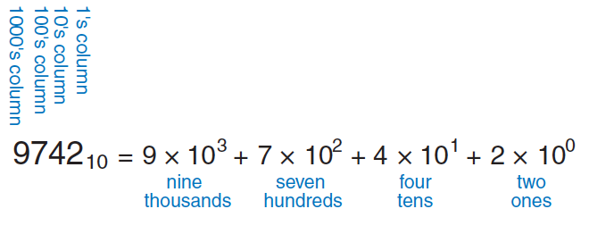
Decimal Numbers
In elementary school, we learned to do arithmetic in decimal
just as we have ten fingers, there are ten decimal
digits: 0, 1, 2, …, 9
Decimal digits are joined together to form longer decimal numbers
each column of a decimal number has ten times the weight of the previous column
from right to left, the column weights are 1, 10, 100, 1000, and so on
Decimal numbers are referred to as base 10
An N-digit decimal number represents one of 10^{N} possibilities
range of the number
a three-digit decimal number represents one of 1000 possibilities in the range 0 to 999

Slide 4
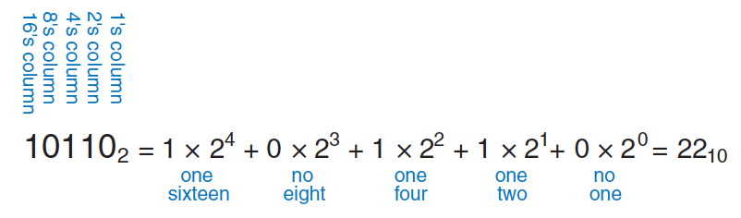
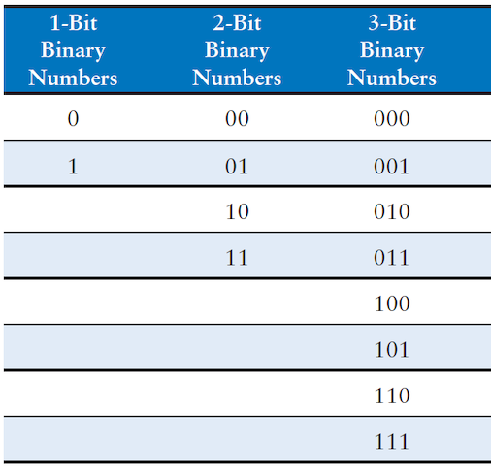
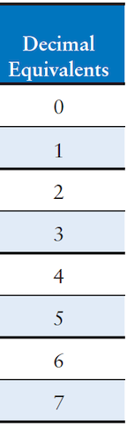
Binary Numbers
Bits (binary digit) represent one of two values, 0 or 1, and are joined together to form binary numbers
a column of a binary number has twice the weight of the previous column (base 2)
column weights are 1, 2, 4, 8, 16, 32, 64, 128, 256, 512, 1024, 2048, 4096, 8192, 16384, 32768, 65536
An N-bit number represents one of 2^{N} possibilities

Slide 5
Decimal to binary conversion
Convert the decimal number 84₁₀ to binary
Working from the left:
1, 2, 4, 8, 16, 32, 64, 128, 256, 512, 1024, 2048, 4096, 8192, 16384, 32768, 65536
the largest power of 2 less than or equal to 84 is 64, so there is a 1 in the column 7, leaving 84 − 64 = 20; 20 < 32, so there is a 0 in column 6; 20 ≥ 16, so there is 1 in the column 5, leaving 20 − 16 = 4; 4 < 8, so there is 0 in column 4; 4 ≥ 4, so there is 1 in column 3, leaving 4 − 4 = 0; thus, there must be 0 in columns 2 and 1. Putting all together, 84₁₀ = 1010100₂
Working from the right:
repeatedly divide the number by 2, the remainder goes in each column
84/2 = 42, so 0 goes in column 1; 42/2 = 21, so 0 goes in column 2; 21/2 = 10 with the remainder of 1 going in column 3; 10/2 = 5, so 0 goes in column 4; 5/2 = 2 with the remainder of 1 going in column 5; 2/2 = 1, so 0 goes column 6. Finally, 1/2 = 0 with the remainder of 1 going in column 7. Again, 84₁₀ = 1010100₂

Slide 6
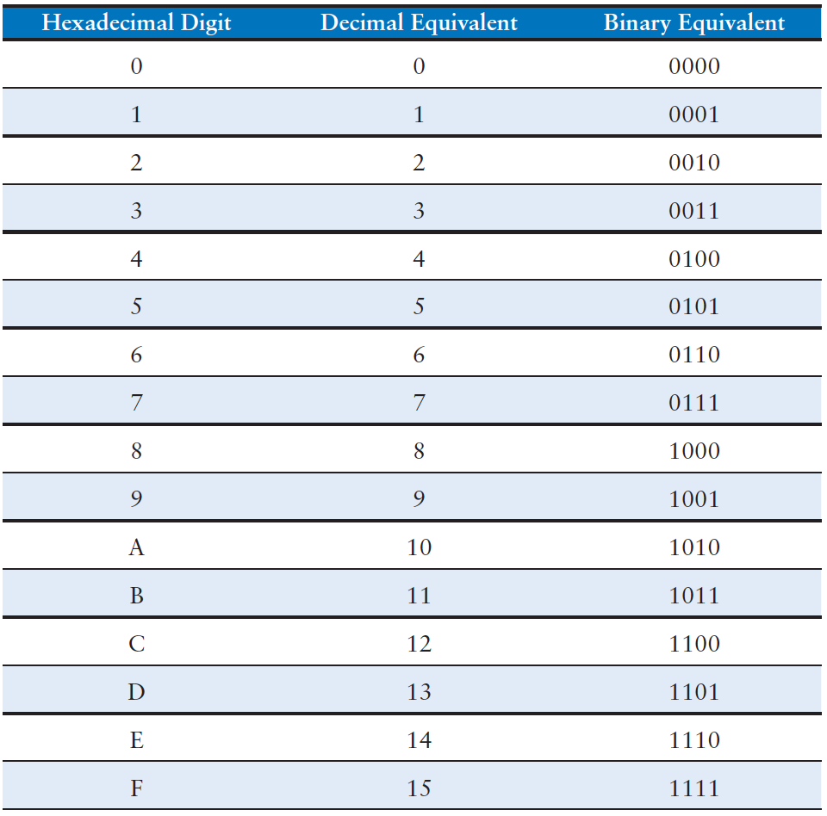
Hexadecimal Numbers
Writing long binary numbers becomes tedious and prone to error
A group of four bits represents one of 2⁴ = 16 possibilities
it is convenient to work in base 16, called hexadecimal
use the digits 0 to 9 along with the letters A to F
Conversion between hexadecimal and binary is easy because each hexadecimal digit directly corresponds to four binary digits
convert 2ED₁₆ to binary
2₁₆ = 0010₂, E₁₆ = 1110₂, D₁₆ = 1101₂, so 2ED₁₆ = 0010 1110 1101₂
convert 1111010₂ to hexadecimal
1010₂ = A₁₆, 111₂ = 7₁₆, so 1111010₂ = 7A₁₆

Slide 7
Bytes
A group of eight bits is called byte
it represents one of 2⁸ = 256 possibilities
size of objects stored in memories is measured in bytes rather than bits
A group of four bits is called nibble
it represents one of 2⁴ = 16 possibilities
a hexadecimal digit stores one nibble
no longer a commonly used unit
Microprocessors handle data in chunks called words
the size of a word depends on the architecture of the microprocessor
most computers had 64-bit processors, indicating that they operate on 64-bit words, older computers handling 32-bit words were also widely available
Within a group of bits…
…the bit in the first column (on the right) is called the least significant bit (lsb)
…the bit at the other end (on the left) is called the most significant bit (msb),
Similarly, within a word: the bytes are identified as least significant byte (LSB) through most significant byte (MSB)

Slide 8
Kilo, Mega and Giga
By coincidence, 2¹⁰ = 1024 ≈ 10³ so the term kilo indicates 2¹⁰
2¹⁰ bytes is one 1 KB
Similarly, mega (million) indicates 2²⁰ ≈ 10⁶
And giga (billion) indicates 2³⁰ ≈ 10⁹
Using these approximation and remembering the powers of two up to 2⁹, it is easy to estimate any power of two
1, 2, 4, 8, 16, 32, 64, 128, 256, 512
find the approximate value of 2²⁴ without using a calculator
split the exponent into a multiple of ten and the remainder
2²⁴ = 2²⁰ × 2⁴; 2²⁰ ≈ 1 million; 2⁴ = 16; so 2²⁴ ≈ 16 million (16,777,216, close enough)

Slide 9
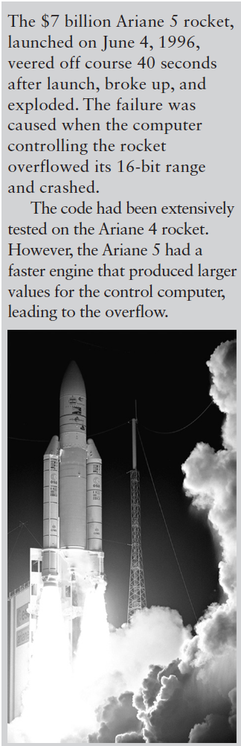
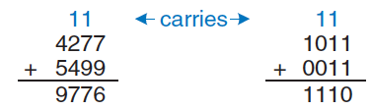
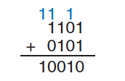
Binary Addition
Like decimal addition, but easier
if the sum of two numbers is greater than what fits in a single digit (1), we carry a 1 into the next column (carry bit)
We operate on a fixed number of digits, so additions can overflow
if the result is too big to fit in the available digits
a 4-bit number has the range [0, 15], an addition overflows if the result exceeds
the fifth bit is discarded, producing an incorrect result in the remaining four bits
this can be detected by checking for a carry out of the most significant column

Slide 10
Signed Binary Numbers
We need to represent also negative numbers
Sign/magnitude
use the most significant bit as the sign and the remaining N − 1 bits as the magnitude (absolute value): a sign bit of 0 indicates positive and a sign bit of 1 indicates negative
intuitively appealing: match our way of writing negative numbers with a minus sign followed by the magnitude
problems:
ordinary binary addition does not work
−5₁₀ + 5₁₀ gives 1101₂ + 0101₂ = 10010₂, which is nonsense
it is odd that both +0 and −0 exist, both indicate zero…
Two’s complement
identical to unsigned binary numbers except that the most significant bit has a weight of −2^{N−1} (instead of 2^{N−1})
this overcomes the shortcomings of sign/magnitude numbers
zero has a single representation
ordinary addition works

Slide 11
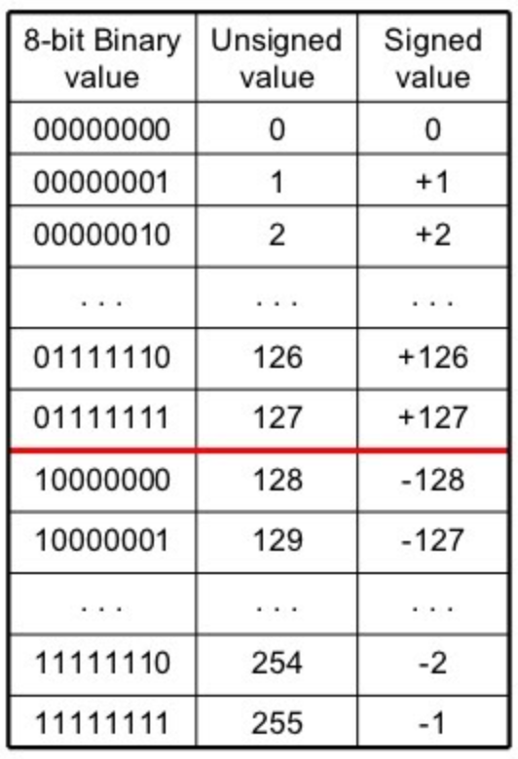
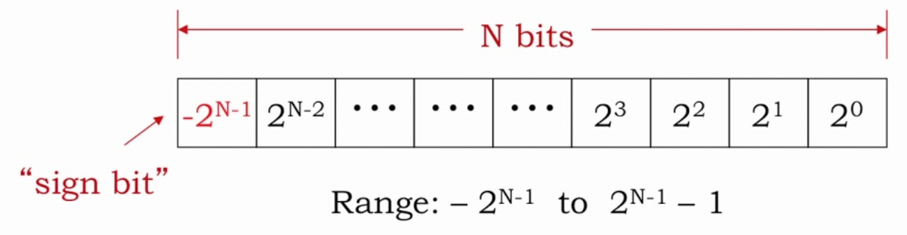
Two’s complement representation
Zero is written as all zeros
00…000₂
The most positive number has a 0 in the msb and 1 elsewhere
01…111₂ = 2^{N−1} − 1
The most negative number has a 1 in the msb and 0 elsewhere
10…000₂ = −2^{N−1}
−1 is written as all ones:
11…111₂
Notice that the most significant bit can be viewed as the sign bit

Slide 12
Two’s complement negative number
The sign of a two’s complement number is reversed by inverting the bits in the number (called one’s complement) and then adding 1
reversing the sign
adding 1
Find the representation of −2₁₀ as a 4-bit two’s complement number
represent the magnitude: +2₁₀ = 0010₂
invert 0010₂ to 1101₂
add 1: 1101₂ + 1₂ = 1110₂
so, −2₁₀ is 1110₂
Find the decimal value of the 4-bit two’s complement number 1001₂
1001₂ has a leading 1, so it must be negative
Invert the magnitude 1001₂ = 0110₂
add 1: 0110₂ + 1₂ = 0111₂ = 7₁₀
so, 1001₂ = −7₁₀

Slide 13
Addition and Subtraction
Addition works properly for both positive and negative numbers
when adding N-bit numbers, the carry of the Nth bit is discarded
compute −2₁₀ + 1₁₀ and −7₁₀ + 7₁₀ using 4-bit two’s complement numbers
−2₁₀ + 1₁₀ = 1110₂ + 0001₂ = 1111₂ = −1₁₀
−7₁₀ + 7₁₀ = 1001₂ + 0111₂ = 10000_{2,} the fifth bit is discarded, leaving 0000₂
Subtraction is performed by taking the two’s complement of the second number, then adding
compute 5₁₀ − 3₁₀ and 3₁₀ − 5₁₀ using 4-bit two’s complement numbers
3₁₀ = 0011₂, take its two’s complement −3₁₀ = 1101₂, then add 5₁₀ + (−3₁₀) = 0101₂ + 1101₂ = 0010₂ = 2₁₀ notice that the carry of the most significant position is discarded because the result is stored in four bits
take the two’s complement of 5₁₀ to obtain −5₁₀ = 1011₂, add 3₁₀ + (−5₁₀) = 0011₂ + 1011₂ = 1110₂ = −2₁₀

Slide 14
Zero
The two’s complement of 0 is found by inverting all the bits (11…111₂) and adding 1, which produces all 0’s, disregarding the carry out of the msb
zero is always represented with all 0’s
unlike the sign/magnitude system, it has no separate -0 representation
zero is considered positive because its sign bit is 0
The range of an N-bit two’s complement number spans [−2^{N−1}, 2^{N−1} − 1]
there is one more negative number than positive number because there is no −0
The most negative number 10…000₂ = −2^{N−1} is called the weird number
its two’s complement is found by inverting the bits (01…111₂) and adding 1, which produces 10…000₂, the weird number again.
it has no positive counterpart

Slide 15
Overflow
Adding two N-bit positive numbers or negative numbers may cause overflow
if the result is greater than 2^{N−1} − 1 or less than −2^{N−1}
unlike unsigned numbers, a carry out of the most significant column does not indicate overflow
Overflow occurs if the two numbers have the same sign bit, and the result has the opposite sign bit
Compute 4₁₀ + 5₁₀ using 4-bit two’s complement numbers
4₁₀ + 5₁₀ = 0100₂ + 0101₂ = 1001₂ = −7₁₀
the result overflows, producing an incorrect negative result
if the computation had been done using five bits, the result 01001₂ = 9₁₀ would have been correct

Slide 16
Sign extension
When a two’s complement number is extended to more bits, the sign bit must be copied into the most significant bit positions
this process is called sign extension
For example:
3₁₀ and −3₁₀ are written as 4-bit two’s complement numbers 0011₂ and 1101₂
a sign-extension to seven bits is 0000011₂ and 1111101₂

Slide 17
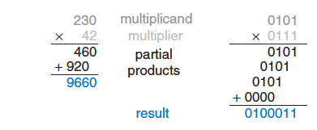
Multiplication
Multiplication of unsigned binary numbers is like decimal multiplication but involves only 1 and 0
partial products are formed by multiplying a single digit of the multiplier with the entire multiplicand
the shifted partial products are summed to form the result
partial products in the binary case are either the multiplicand or all 0

Slide 18
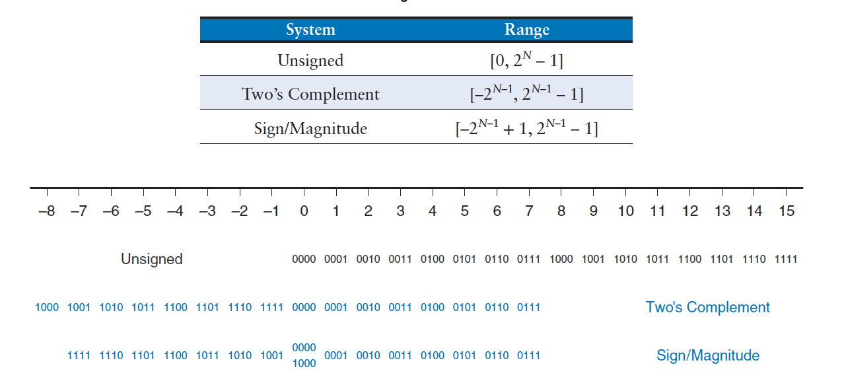
Comparison

Slide 19
Fractional Numbers
Computers operate on both integers and fractions
we have only considered representing signed or unsigned integers
fixed- and floating-point number systems that can represent rational numbers
Fixed-point numbers are analogous to decimals
some of the bits represent the integer part, and the rest represent the fraction
Floating-point numbers are analogous to scientific notation
with a mantissa and an exponent

Slide 20
Fixed-Point Number Systems (1)
It has an implied binary point between the integer and fraction bits
analogous to the point between the integer and fraction digits of a decimal number
0110.1100 = 2²+2¹+2⁻¹+2⁻² = 6.75
Signed fixed-point numbers can use either
sign/magnitude notation
the most significant bit is used to indicate the sign
-2.375₁₀ = 1010.0110₂
two’s complement
inverting the bits of and adding a 1 to the least significant (rightmost) bit
-2.375₁₀ = 1101.1010₂
Like all binary number representations, fixed-point numbers are just a collection of bits
there is no way of knowing the existence of the binary point
only through agreement of those people interpreting the number

Slide 21
Fixed-Point Number Systems (2)
We use
Ua.b to denote an unsigned fixed-point number with a integer bits and b fraction bits;
Qa.b to denote a signed (two’s complement) fixed point number with a integer bits (including the sign bit) and b fractional bits
Fixed-point number systems are commonly used in digital signal processing (DSP), graphics, and machine learning application
Q1.15 (also known as Q15) is the most common format, storing signed numbers in the range (−1, 1) with 15 bits of precision
Q1.31 (also called just Q31) is sometimes used for higher precision intermediate results such as in a Fast Fourier Transform
U8.8 is sometimes used for sensor readings sampled by analog/digital converters (ADCs)
Note that all formats pack into 16- or 32-bit words for efficient storage in computer memories

Slide 22
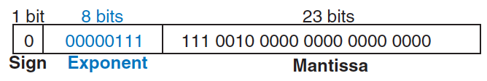
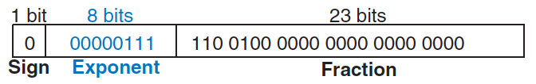
Floating-Point Number Systems (1)
Analogous to scientific notation
have a sign, mantissa (M), base (B), and exponent (E)
± M * B^{E}
4.1*10³ is the scientific notation for 4100 (mantissa 4.1, base 10, and exponent 3)
the decimal point “floats" to the position right after the most significant digit
allowing the representation of very large and very small number
32-bit floating-point numbers
base 2, 1 sign bit, 8 exponent bits, and 23 mantissa bits
228₁₀ = 11100100₂ = 1.11001*2⁷ = 1.11001*2⁰⁰⁰⁰⁰¹¹¹
Notice that the first bit of the mantissa is always 1 and therefore need not be stored (implicit leading one)
this frees up an extra bit for useful data

Slide 23
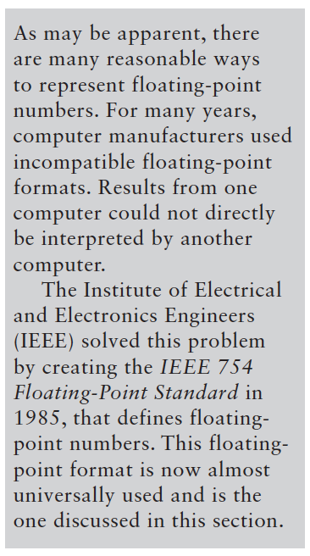
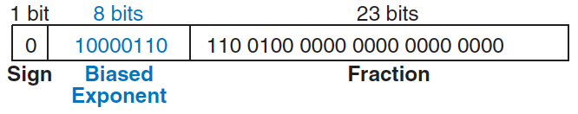
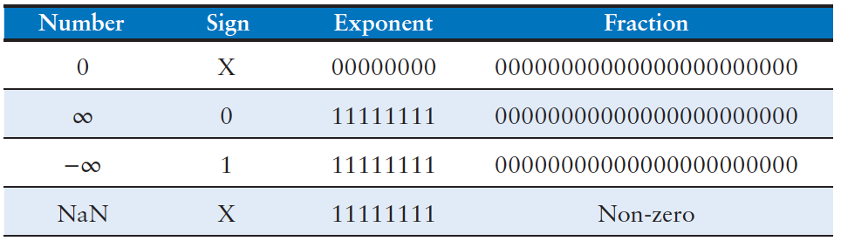
Floating-Point Number Systems (2)
The exponent needs to represent both positive and negative exponents
use a biased exponent, which is the original exponent plus a constant bias
32-bit floating-point uses a bias of 127
exponent 7 is biased 7 + 127 = 134 = 10000110₂
exponent −4 is biased −4 + 127 = 123 = 01111011₂
This notation conforms to the IEEE 754 floating-point standard
228₁₀ = 11100100₂ = 1.11001*2¹⁰⁰⁰⁰¹¹⁰
The standard has special cases to represent zero, infinity, and illegal results

Slide 24
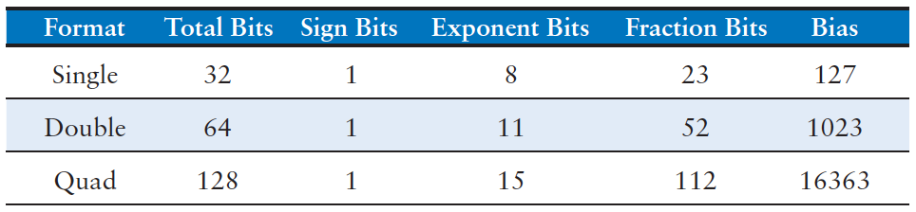
Floating-Point Number Systems (3)
So far, we have examined 32-bit floating-point numbers
single-precision (float)
The IEEE 754 standard also defines
64-bit double-precision numbers (doubles)
128-bit quadruple-precision numbers (quads), not yet widely supported
Today, growing importance of machine learning, new formats are emerging:
Google BFloat16 (exponent: 8 bits, mantissa: 8 bits)
IMB DLFloat16 (exponent: 6 bits, mantissa: 10 bits)
NVIDIA FP8 (exponent: 4 bits, mantissa: 4 bits)
Tesla CFloat8 (exponent: 5 bits, mantissa: 4 bits)
NVIDIA FP4 (introduced in GPU Blackwell in 2024)

Slide 25
Exercises (1)
Ex2.1: The Babylonians developed the sexagesimal (base 60) number system about 4000 years ago. How many bits of information is conveyed with one sexagesimal digit? How do you write the number 4000₁₀ in sexagesimal?
Solution: each digit conveys log₂60 = 5.91 bits of information. 4000₁₀ = 1 6 40₆₀ (1 in the 3600 column, 6 in the column 60, and 40 in the column 1)
Ex2.2: How many different numbers can be represented with 16 bits?
Solution: 2¹⁶ = 65.536 numbers
Ex2.3: What is the largest unsigned 32-bit binary number?
Solution: 2³²-1 = 4.294.967.295
Ex2.4: What is the largest 16-bit binary number that can be represented with (a) unsigned numbers? (b) two’s complement numbers? (c) sign/magnitude numbers?
Solution: (a) 2¹⁶-1=65.535; (b) 2¹⁵-1=32.767; (c) 2¹⁵-1=32.767

Slide 26
Exercises (2)
Ex2.5: Convert the following unsigned binary numbers to decimal and to hexadecimal: (a) 1010₂; (b) 110110₂; (c) 11110000₂; (d) 000100010100111₂
Solution: (a) 10, (b) 54, (c) 240, (d) 2215; (a) A, (b) 36, (c) F0, (d) 8A7
Ex2.6: Convert the following hexadecimal numbers to decimal: (a) A5₁₆; (b) 3B₁₆; (c) FFFF₁₆, (d) D0000000₁₆
Solution: (a) 165; (b) 59; (c) 65.535; (d) 3.489.660.928
Ex2.7: Convert the following two’s complement binary numbers to decimal: (a) 1010₂; (b) 110110₂; (c) 01110000₂; (d) 10011111₂
Solution: (a) -6; (b) -10; (c) 112; (d) -97
Ex2.8: Convert the following decimal numbers to 8-bit two’s complement numbers or indicate that the decimal number would overflow the range: (a) 42₁₀; (b) −63₁₀; (c) 124₁₀; (d) −128₁₀; (e) 133₁₀
Solution: (a) 00101010; (b) 11000001; (c) 01111100; (d) 10000000; (e) overflow

